Slide 1

Fundamentals of Accounting
Jahangir Tanveer

Slide 2
The Four Financial Statements
1. An income statement presents the revenues and expenses and resulting net income or net loss for a specific period of time.
2. An owner’s equity statement summarizes the changes in owner’s equity for a specific period of time.
3. A balance sheet reports the assets, liabilities, and owner’s equity at a specific date.
4. A statement of cash flows summarizes information about the cash inflows (receipts) and outflows (payments) for a specific period of time.

Slide 3
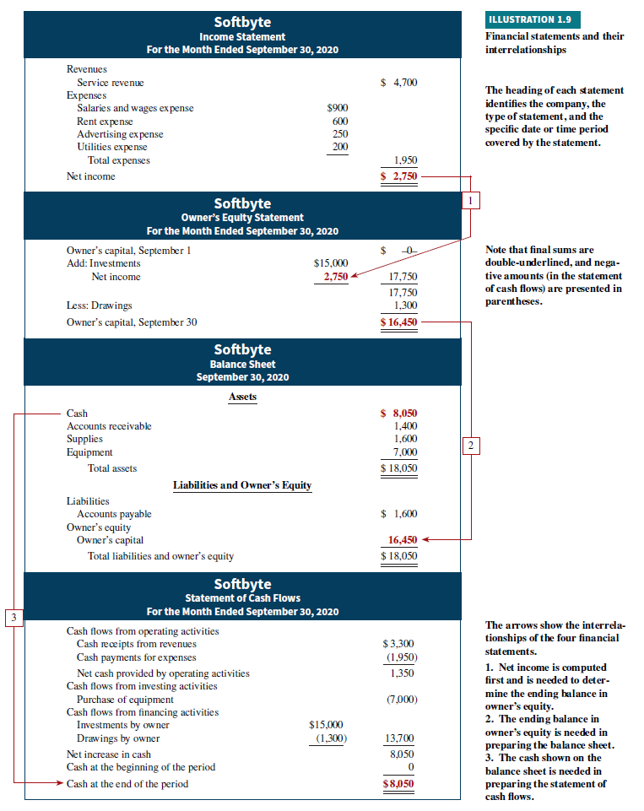

Slide 4
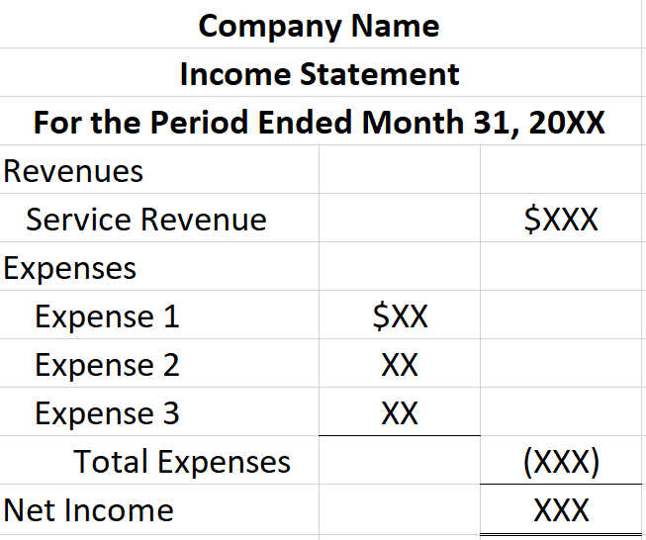
Income Statement Format

Slide 5
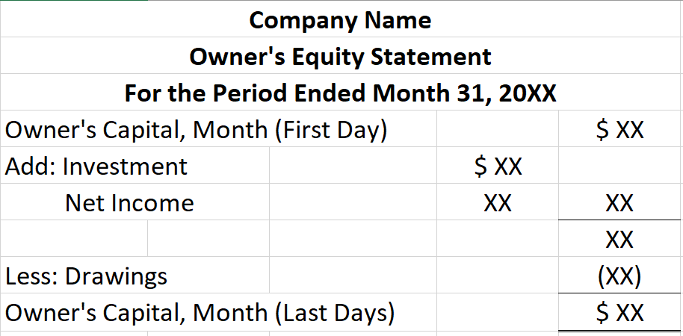
Equity Statement Format

Slide 6
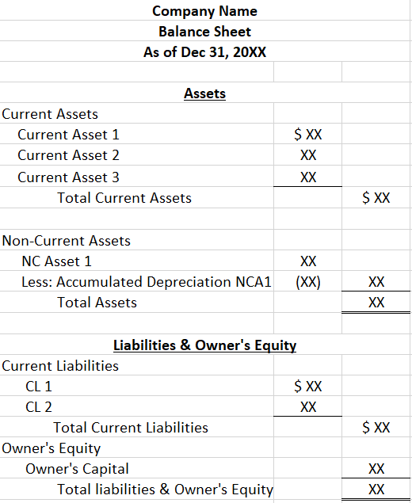
Balance Sheet Format

